Slide 1
GMAC Review
Yang Lei

Slide 2
CONTENT
Introduction
Integration
Verification

Slide 3
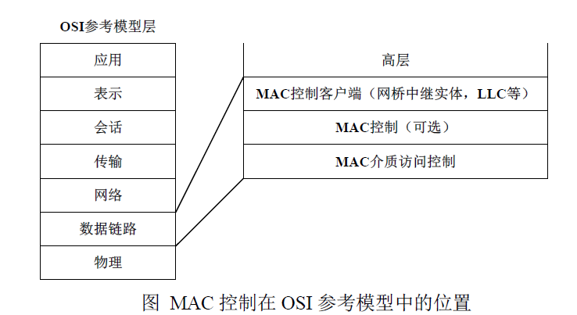
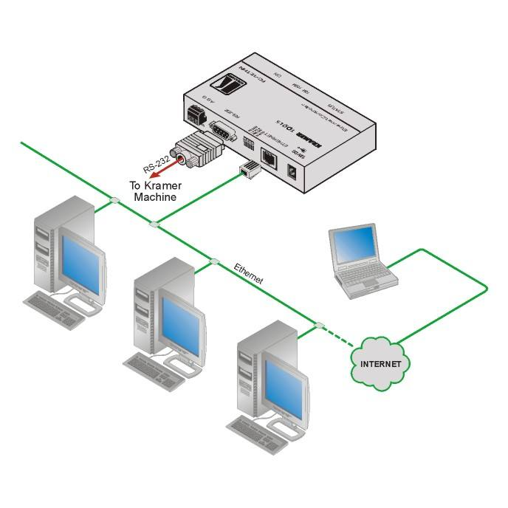
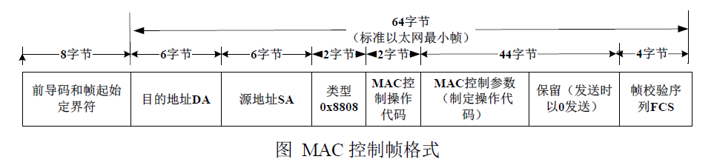
Introduction

Slide 4
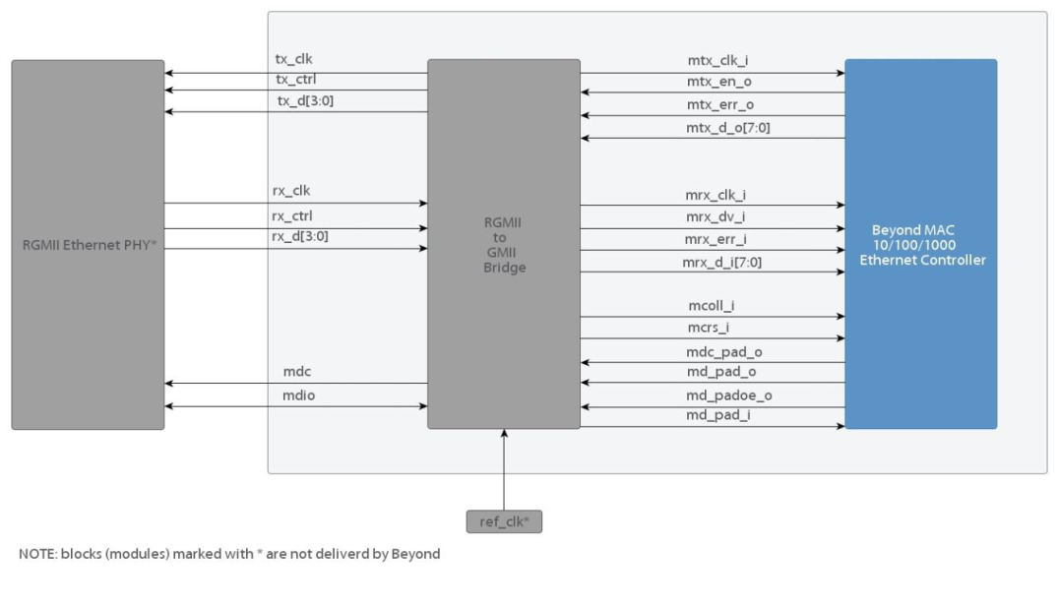
Integretion
Feature:
■ Programmable 10/100 or 1000 Mbps operation ■ Full- or half-duplex operation
■ Reduce Gigabit Media Independent Interface (RGMII) for 1Gbps ■ MDIO interface for PHY configuration and management

Slide 5
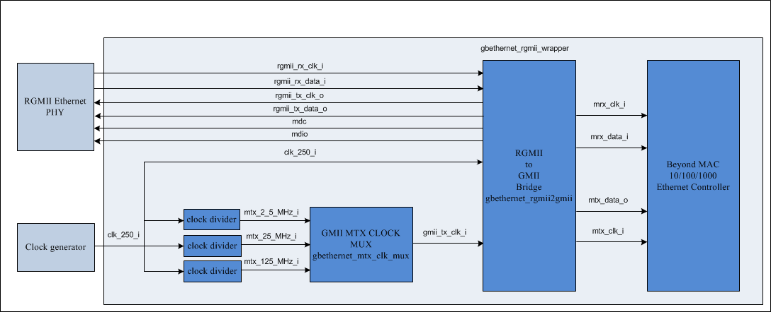
Integration
■ Clk:
■ Area: 0.04mm
■ Performance: meet 1000Mb/s

Slide 6

Frame transmitter
1.Store the frame to the memory.
2.Associate the TXBD in the Gbethernet MAC core with packet written to the memory (length, pad, crc, etc.).
3.Enable the TXEN bit in MODE register to 1.
TX Buffer Descriptors

Slide 7

Frame Reception
1.Set the receive buffer descriptor to be associated with the received packet and mark it as empty.
2.Enable the RECEN bit in the MODE register to 1.
RX Buffer Descriptors

Slide 8
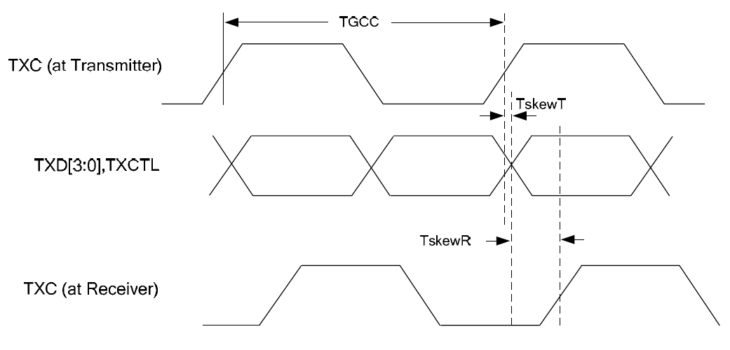
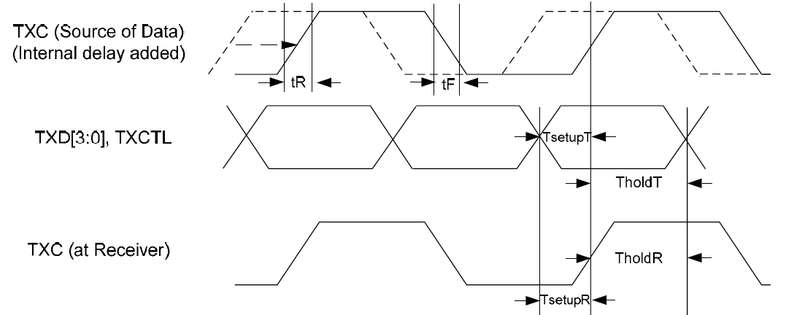
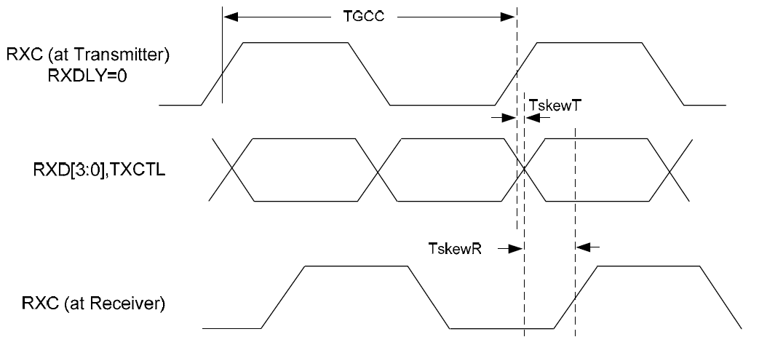
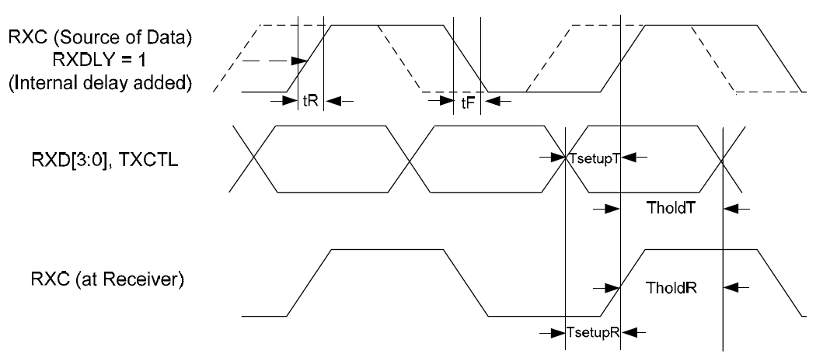
RGMII TX & RX interface
rgmii tx interface
rgmii rx interface

Slide 9
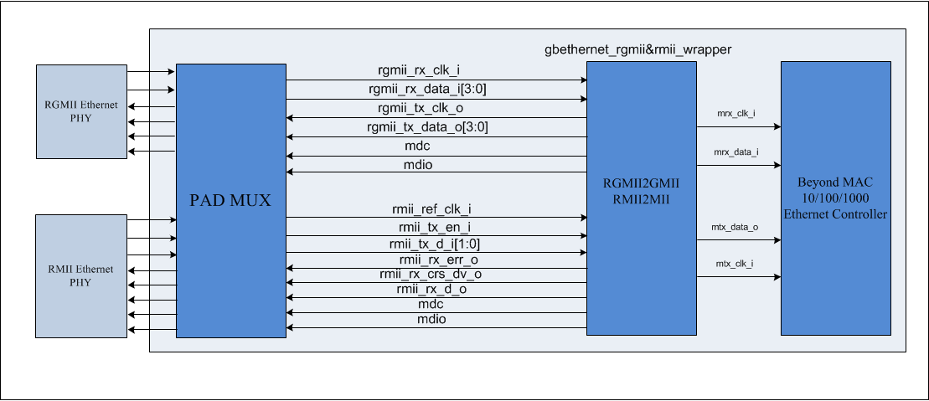
RGMII & RMII interface
rgmii rx interface

Slide 10
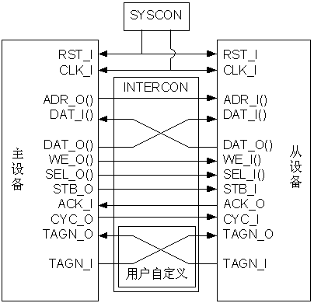
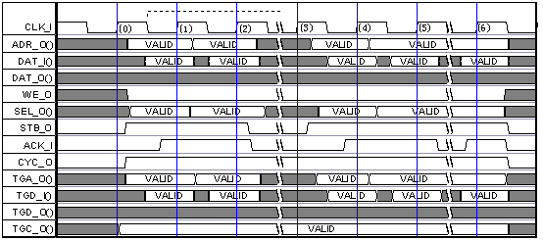
Bus Interface
■ Wishbone bus
Wishbone bus multi_read

Slide 11
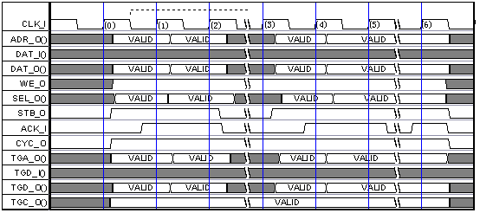
Bus Interface
■ Wishbone bus
Wishbone bus multi_write

Slide 12
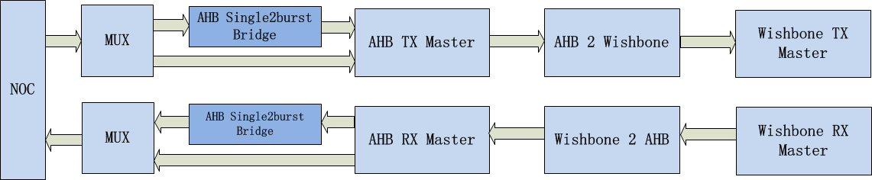
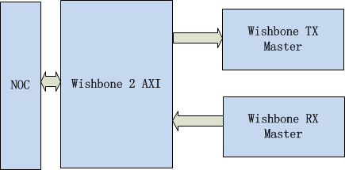
Bus Interface
■ Wishbone 2 AHB
■ Wishbone 2 AXI is better

Slide 13
Sim
■ Local sim
./rtl_sim –d gbeth_top –r gbeth_receiver_tcs –deb
./rtl_sim –d gbeth_top –r gbeth_transmitter_tcs -deb
./rtl_sim –d gbeth_top –r gbeth_half_duplex_tcs –deb
./rtl_sim –d gbeth_top –r gbeth_loopback_tcs –deb
./rtl_sim –d gbeth_top –r gbeth_wishbone_master_tcs
./rtl_sim –d gbeth_top –r gbeth_receiver_tcs
–def GBETHERNET_RGMII_IMPLENMENTED –deb
./rtl_sim –d gbeth_top –r gbeth_transmitter_tcs
–def GBETHERNET_RGMII_IMPLENMENTED –deb

Slide 14
Sim
■ Soc sim
eth_rgmii_phy.v
■ Veloce sim
velrun –do run.do.linux –exe ./tb-dpi.veloce
run epgm

Slide 15
EMMC Review
Yang Lei

Slide 16
CONTENT
Introduction
Integration
Programming
Sim

Slide 17
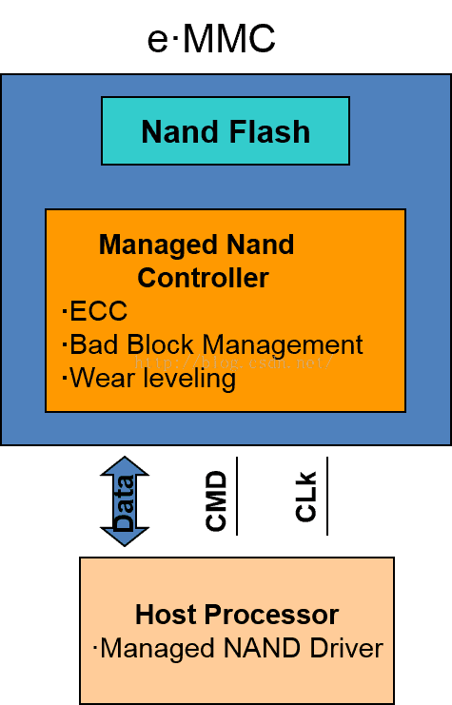
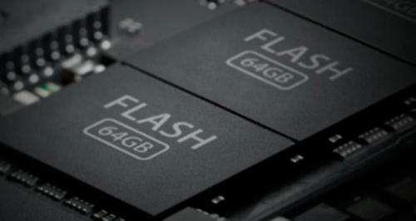
Introduction

Slide 18
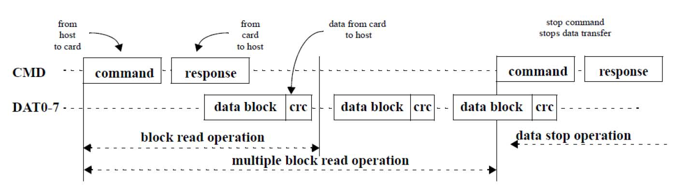
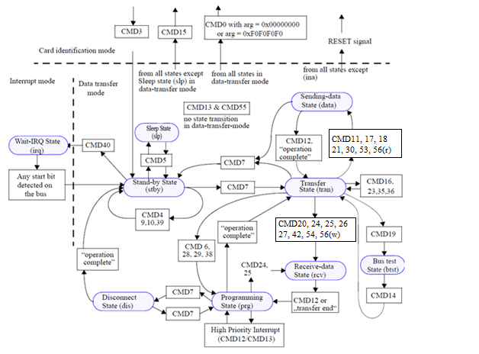
Introduction

Slide 19
Integration
Feature:
■ Supports eMMC protocols including eMMC 5.1 ■ Supports tuning
■ Supports Supports data transfer types for CPU, SDMA, ADMA2, ADMA3
■ Supports legacy, High Speed SDR, HS200 speed modes

Slide 20
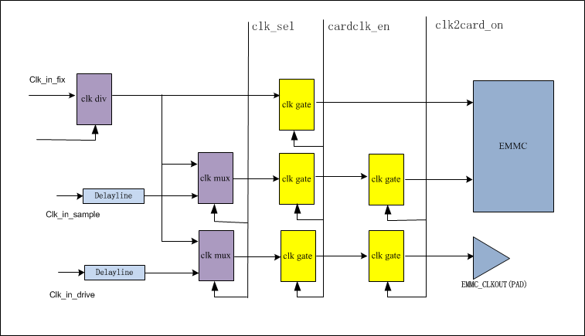
Integration
■ Clk
■ Area: 0.03mm
■ Performance: meet HS200 (200MB/s)

Slide 21
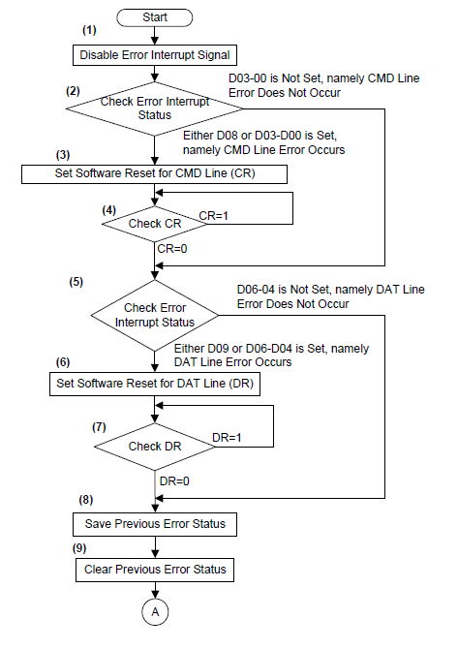
Programming

Slide 22
Sim
■ Local sim
❑ AMBA VIP
❑ EMMC SVT VIP
❑ TEST CASE
test_cust_card_init_wr_rd
test_cust_card_wr_rd_sdma_mode
test_cust_card_wr_rd_adma2_mode
test_cust_card_wr_rd_adma3_mode
test_cust_card_wr_rd_half_duplex_mode

Slide 23
Sim
■ Soc sim
❑ EMMC SVT VIP integration
reference to “VC VIP eMMC UVM User Guide”
■ Veloce sim
❑ EMMC_HEX
preload_CID.hex
preload_CSD.hex
preload_OCR.hex
preload_EXT_CSD.hex
preload_user.hex
preload_gp.hex

Slide 24
SRAM_TOP Review
Yang Lei

Slide 25
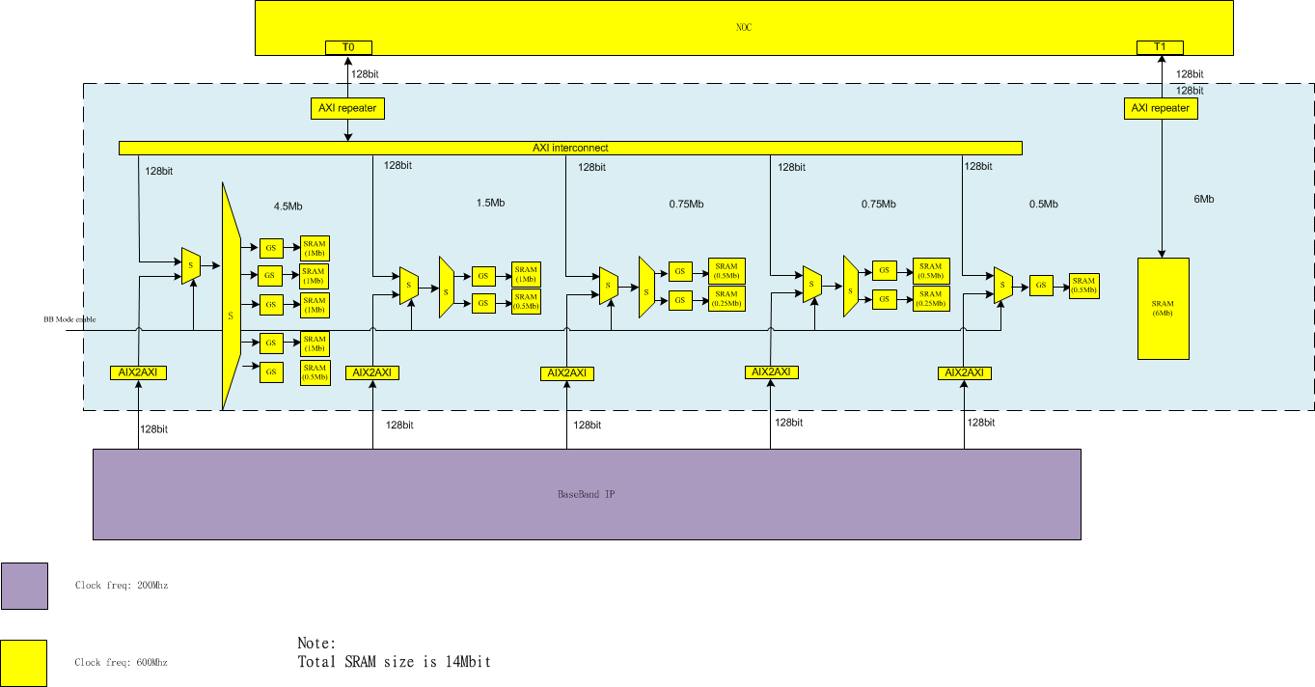
Architecture

Slide 26
DMAC Review
Yang Lei

Slide 27
CONTENT
Introduction
Integration
Application Analysis

Slide 28
Introduction
The dma controller is a highly configurable, highly programmable, high performance, multimaster multichannel DMA Controller with AXI as the bus interface for data transfer.
Feature:
■ Up to 8 channels, one per source and destination pair ■ Up to 2 AXI master interfaces
■ Memory-to-memory, memory-to-peripheral, peripheral-to-memory, and peripheral-to-peripheral DMA transfers

Slide 29
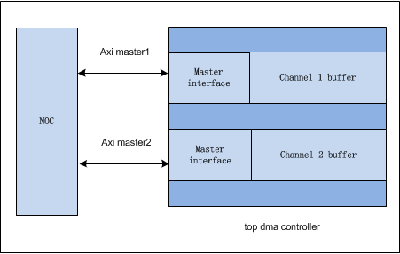
Integration
TOP DMAC
■ 2 AXI 4 master interfaces, each outstanding num 4 ■ 2 channels, each channel buffer depth 64
■ area: 0.09 mm2
■ performance: 4Gb/s

Slide 30
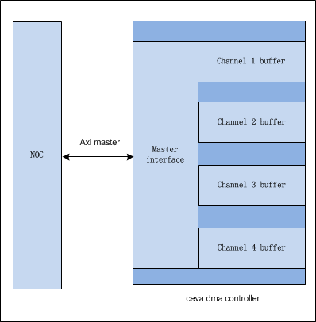
Integration
■ 1 AXI 4 master interfaces, outstanding 8 ■ 4 channels, each channel buffer depth 32
■ area: 0.1mm2
■ performance: 4Gb/s

Slide 31
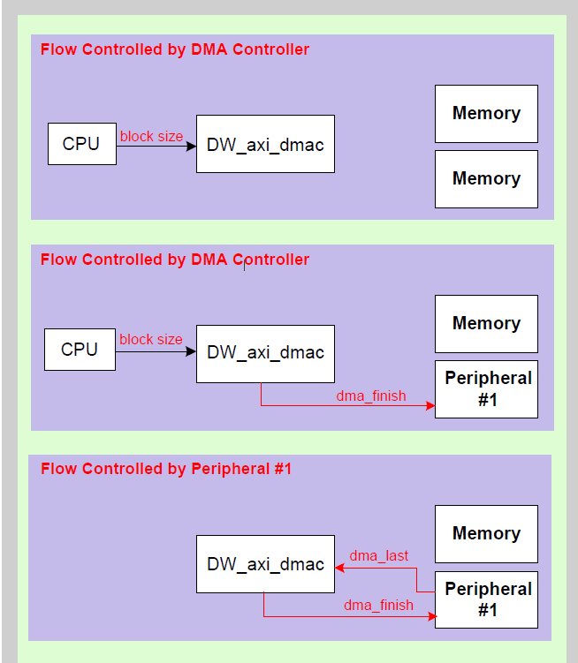
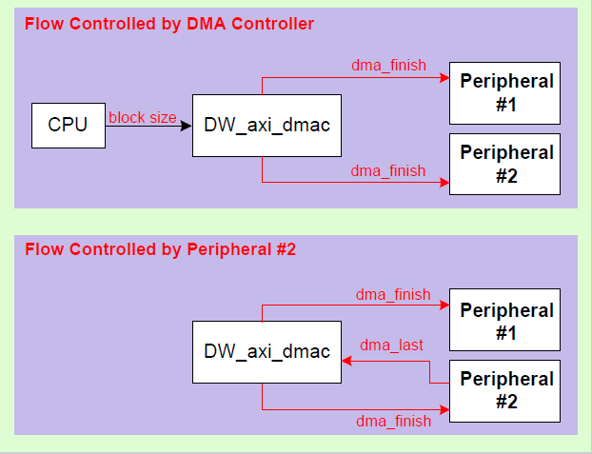
Flow control

Slide 32
Application Analysis
channel num | channel buffer depth | total buffer num/outstanding | NOC outstanding | performance | area
4 | 32 | 128/8 | 8 | 4Gb/s | 0.1mm
4 | 64 | 256/16 | 8 | 5.5Gb/s | 0.15mm
1 | 128 | 128/8 | 8 | 6Gb/s | 0.1mm
4 | 128 | 512/32 | 8 | 6Gb/s | 0.25mm
4 | 256 | 1024/64 | 16 | 9Gb/s | 0.35mm

Slide 33
I2S Review
Yang Lei

Slide 34
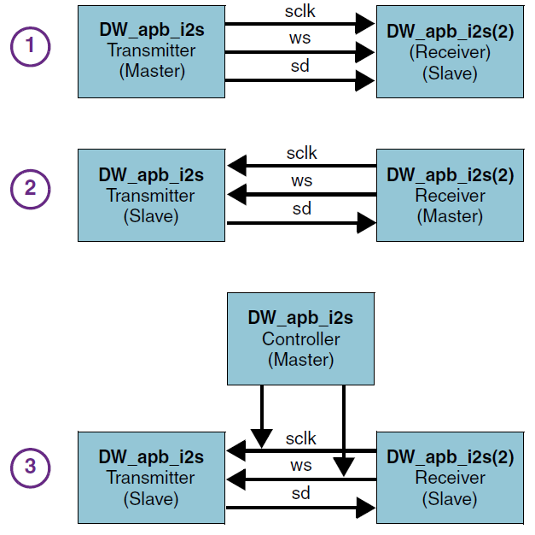
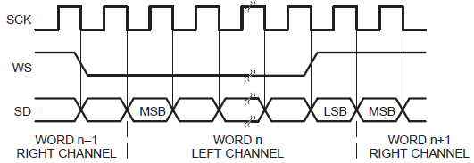
Protocol

Slide 35
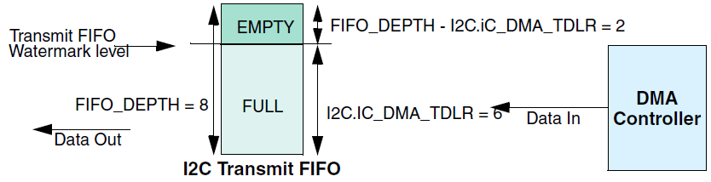
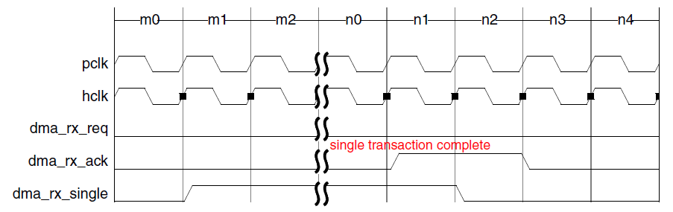
DMA interface

Slide 36


